Slide 1


Introduction to Government Contracting
Should the federal government
be your next client?
Jody King, Assistant Director, Alaska APEX Accelerator
February 5, 2025

Slide 2

Today’s Agenda
Busting Myths & Excuses
Learning a New language
  Commercial vs. Federal
Preparing for a Federal Contracts
  Registrations & Certifications
Finding Solicitations
  Introduction to Market Research
  Building Teaming Relationships & Marketing Plans
Pursuing government contracts?
  Helpful Resources

Slide 3

Busting Myths & Misconceptions
Breaking excuses to sell to the government

Slide 4

Busting Myths & Excuses
x
Going to get rich selling stuff to the government because I can mark up prices because – you know – government…
Government will pay people to help find stuff they can’t find…
The government takes forever to pay…
Too much red tape – too many pages – too hard…
You have to be in business for more than two years… / You have to have past experience in government contracts to get government contracts…
(Experience vs. Past Performance)
I have to have all my certifications before bidding on government contracts.
Because I am/have (fill in cert here,) they have
to give me a contract! / Agencies will pick me because of my small business certs.
8(a) certification will guarantee me contracts.
x
x
x
x
x
x
x

Slide 5

Learning a New Language
Differences between Commercial & Governmental

Slide 6


Commercial vs. Federal
Making the sale – who makes the decisions, who has the buying power?
  Determining need vs. buying goods/services
  Program managers vs. contracting officers
  “Apparent Authority”
Handshake deals, quotes and proposals
  Who signs what? Submitting Quotes, proposals/bids
Legal issues – what to do when it doesn’t work?
  Who signed what?
  Legal structure of federal contracts
Payment Terms – net30 vs. “on receipt of invoice”

Slide 7

Preparing for Contracts
Do you know…?

Slide 8

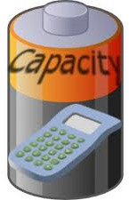


Preparing for Contracts
Do you know your business:
  Capacity
    Do you know what is your operational capacity ceiling?
      Bonding Capacity
        Maximum?
        Available Bond Amount?
      Work in Progress
        Availability of Manpower and/or Equipment
      Contingency Planning & Resources
      Staff Training & Certifications
      Gov’t Contract specific accounting practices
        job codes, Allowable/Allocable expenses (OH), etc.

Slide 9



Preparing for Contracts
Do you know your business:
  Pricing Factors
    Break even points
    Cash flow
    Labor Costs – Wage Determinations
Government registrations:
  System For Award Management (SAM)
  Dynamic Small Business Search (DSBS)
  Applicable small business certification programs

Slide 10
Preparing for Contracts
System for Award Management (SAM)
  Unique Entity Identifier
  SAM username/password => Login.gov – uses email address for entity administrator
  Banking Information: Routing, Account & Bank Phone Numbers
  Tax Identification – EIN or SS
  NAICS Codes (https://www.census.gov/naics/)
  PSC Codes (http://support.outreachsystems.com/resources/tables/pscs/)
  Gross Receipts averaged over 5 year period (Size Standard)
  Average number of employees in a 24 month period (Size Standard)
SAM profiles must be updated yearly & have to be active by bid due date!

Slide 11
Preparing for Contracts
Dynamic Small Business Search (DSBS)
  Found at: https://web.sba.gov/pro-net/search/dsp_dsbs.cfm
  Additional marketing information not provided in SAM profile:
    Any SBA applied certifications (WOSB/EDWOSB, 8(a) & HUBZone)
    Key Words
    Website URL
    Non-federal certifications (CPA, Registered Nurse, etc.)
    Special Equipment
    Capability Narrative
    References -- used as past performance information!
  Did you know that state buyers, prime contractors and other businesses use the DSBS website when looking for potential subs/teaming or vendors?

Slide 12

Small Business Certifications
Government & Commercial Socioeconomic certs

Slide 13

Small Business Certifications
SBA Issued Certification
  8(a) Business Development Program
  Historically Underutilized Business Zone (HUBZone)
  Woman Owned Small Business (WOSB) & Economically Disadvantaged Woman Owned Small Business (EDWOSB) *
  Veteran Owned Small Business (VOSB) & Service-Disabled Veteran-Owned Small Business (SDVOSB)
*SBA-approved third-party certification – WOSB & EDWOSB
  There are four organizations approved by SBA to provide third-party certification (TPC). You may contact them to learn more about their certification process and any associated costs. They are:
      El Paso Hispanic Chamber of Commerce http://www.ephcc.org/
      National Women Business Owners Corporation https://nwboc.org/basicinfo.html
      U.S. Women’s Chamber of Commerce https://www.uswcc.org/certification/
      Women’s Business Enterprise National Council https://www.wbenc.org/

Slide 14
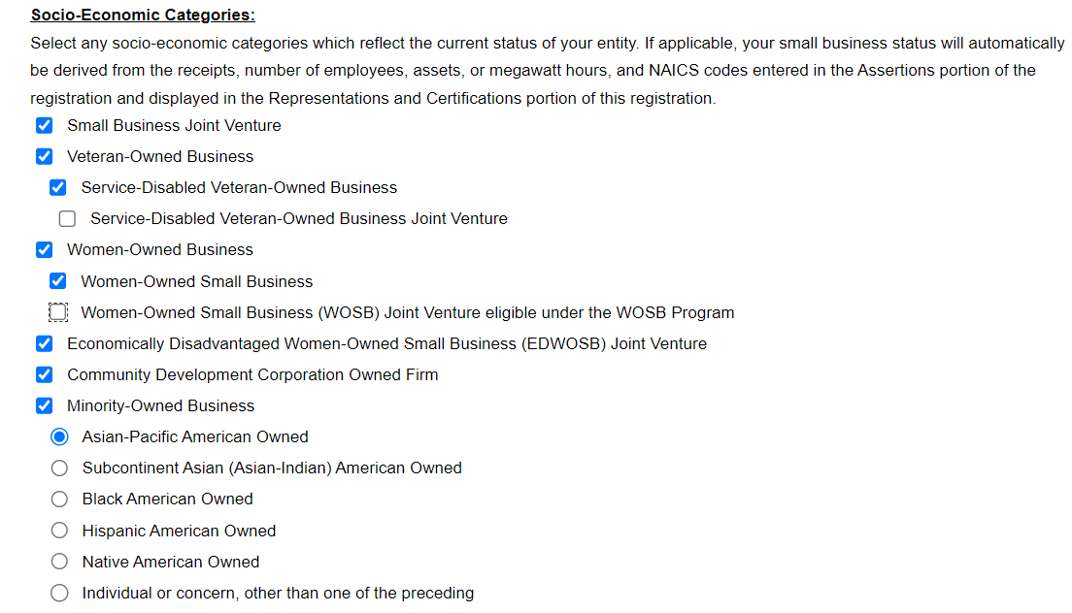
Small Business Certifications
Self Certification via the System for Award Management (SAM)
  Small Business as defined by primary NAICS Codes
  Minority Owned Business
  Woman Owned Business
  Veteran Owned Business

Slide 15

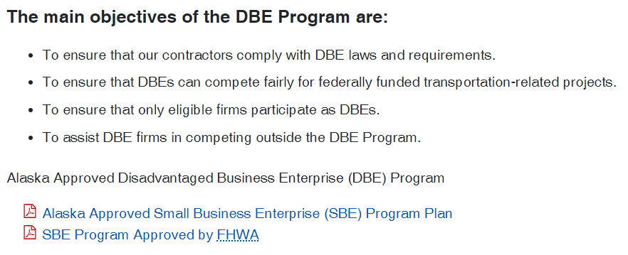
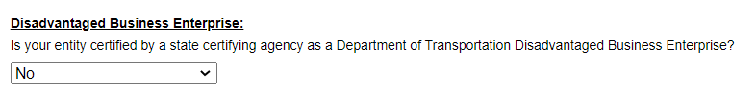
DBE
Department of Transportation – Certified through State Programs
  DBE Disadvantaged Business Enterprise
http://www.dot.state.ak.us/cvlrts/aucp.shtml

Slide 16

Commercial Certifications
Supplier Diversity Programs
  MBE – Minority Business Enterprise
    Northwest Mountain Minority Supplier Development Council https://nwmmsdc.org/
  WBE – Woman Business Enterprise
    Women’s Business Enterprise National Council (WBENC) http://www.wbenc.org/
    US Women’s Chamber of Commerce http://www.uswcc.org/certification
    El Paso Hispanic Chamber of Commerce http://www.ephcc.org/
    National Women Business Owners Corporation http://www.nwboc.org/
  DOBE – Disability-Owned Business Enterprise
    Disability Supplier Diversity Program https://disabilityin.org/
    ConnXus https://connxus.com/dbe-certification/dobe-certification/
  LGBT – Lesbian Gay Bisexual Transgender Business Enterprise
    National LGBT Chamber of Commerce https://nglcc.org/

Slide 17
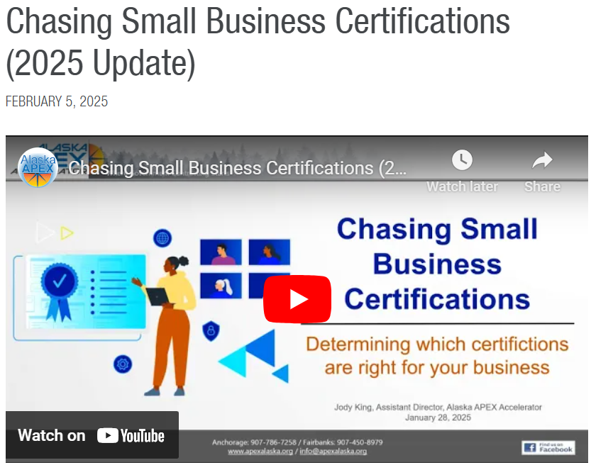
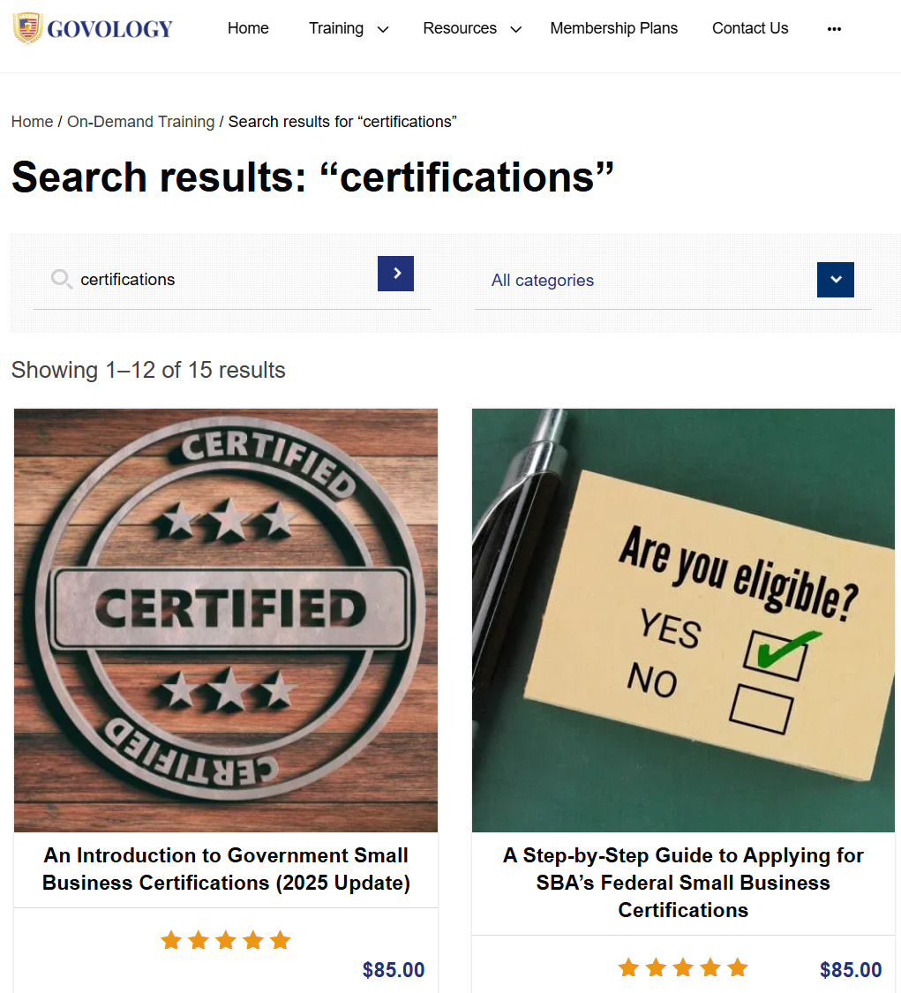
More Certification Training
https://apexalaska.org/
https://govology.com/
https://apexalaska.org/training/chasing-small-business-certifications-2025-update-2/
https://govology.com/government-contracting-webinars-courses/?s=certifications

Slide 18

Researching the Government Market
Finding solicitations – how is it all linked?

Slide 19

Intro to Market Research
Does the Government buy what you sell?
  Introduction to Market Research
    Who are your commercial clients – what agencies are the government equivalents?
    Which agencies are buying your goods/services?
    What is the procurement frequency?
    Where are the purchasing offices located?
    Alaska Region, Centralized buying centers, HQ, etc.
    Prime vs. Subcontractor?
      How to find prime contractors
      Research potential prime/subs
        DSBS, FPDS
    What is the buying cycle – when does the contract renew?

Slide 20


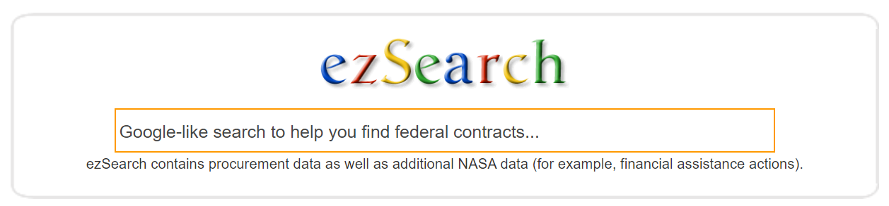


How is it all linked…
Agency Budgets
Industry
Agency Forecast
Agency Website

Slide 21
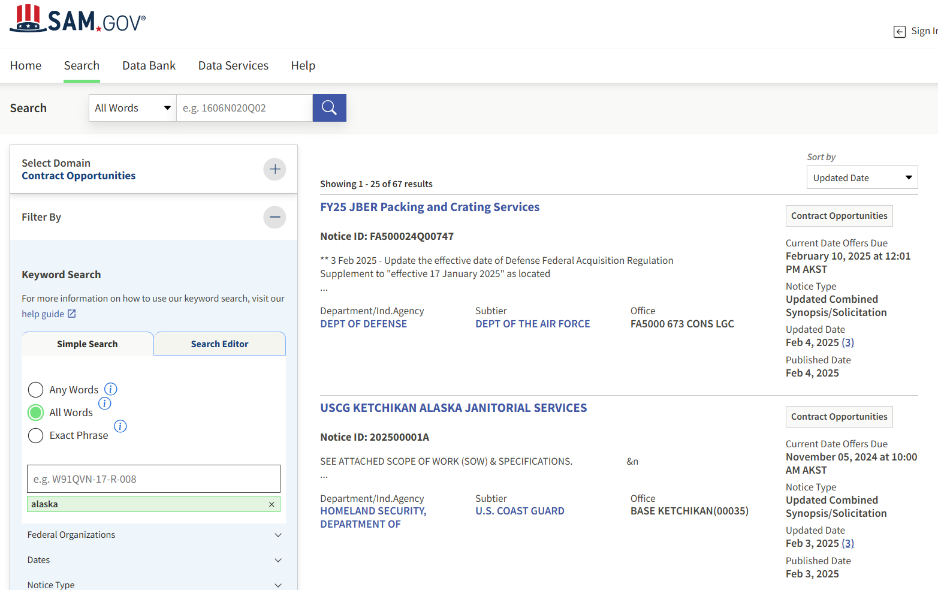

SAM – Contract Opportunities
Possible Search Filters:
Keywords
Federal organizations
Dates
Notice Types
Product or Service Information
  NAICS
  PSC
Set Aside
Place of Performance
Contract Award Details
Status
  Active
  Inactive
Contract Office Details

Slide 22
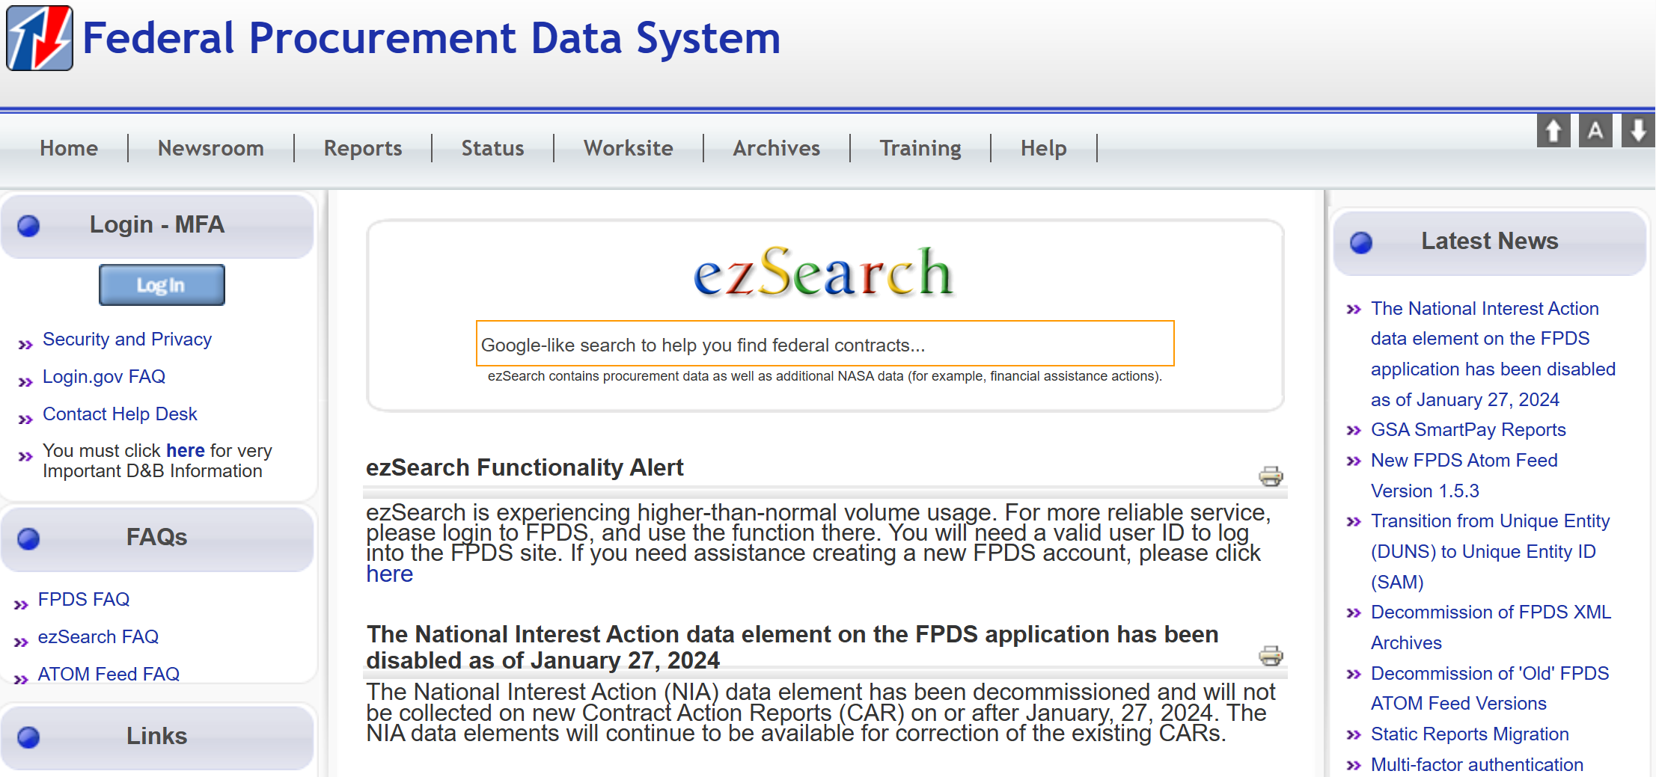
PFDS – past procurement
https://www.fpds.gov

Slide 23
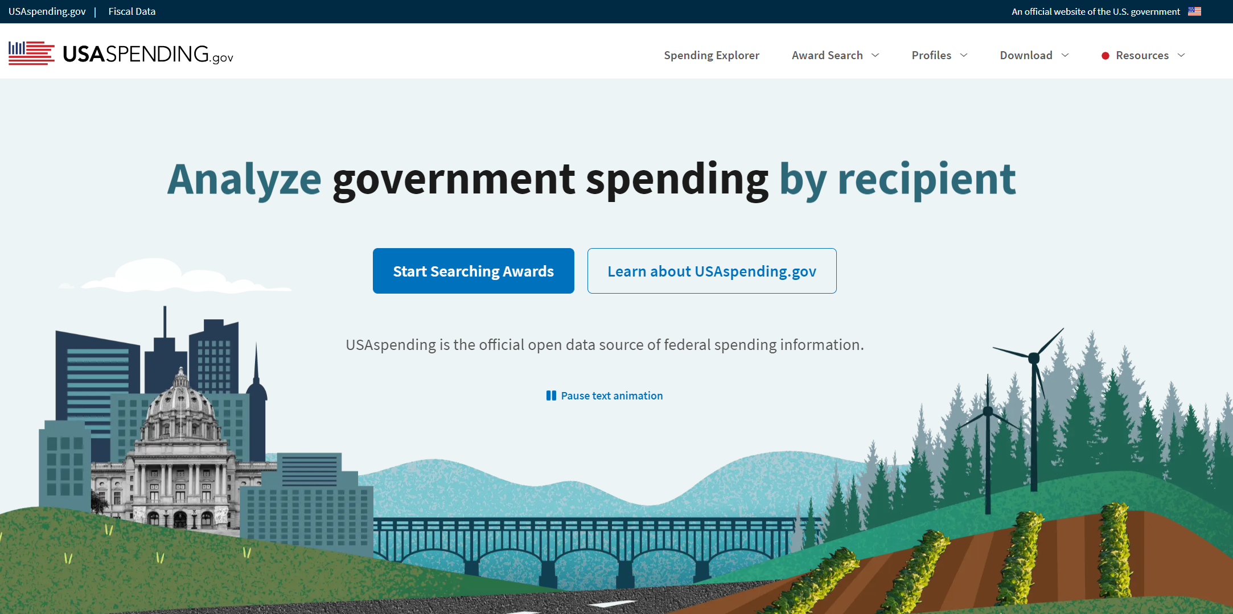
USASpending.gov
https://www.usaspending.gov/

Slide 24
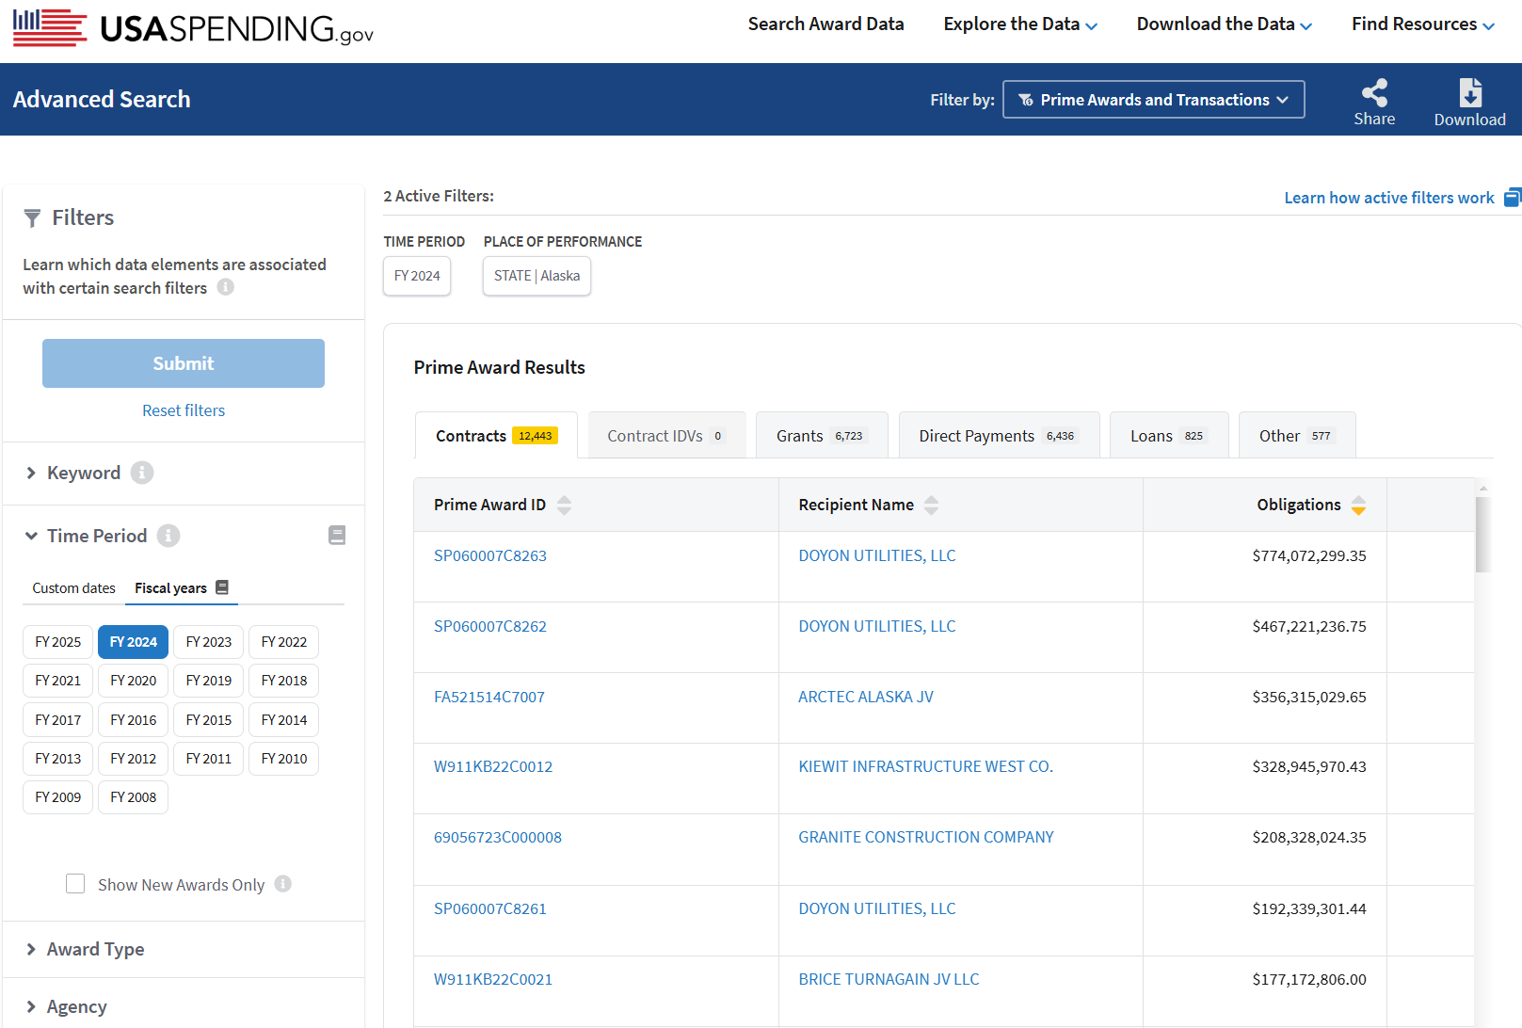

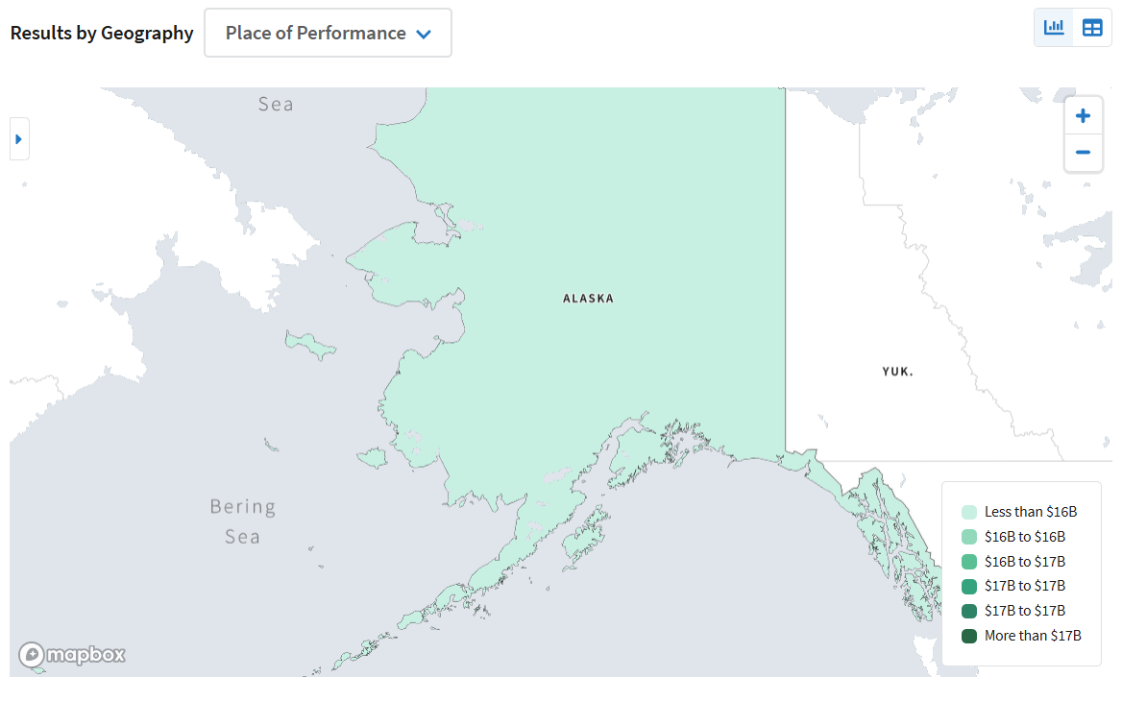
USASpending.gov
Time Period: FY24
Location:
United States
Alaska
Alaska
Obligations $16.1B

Slide 25
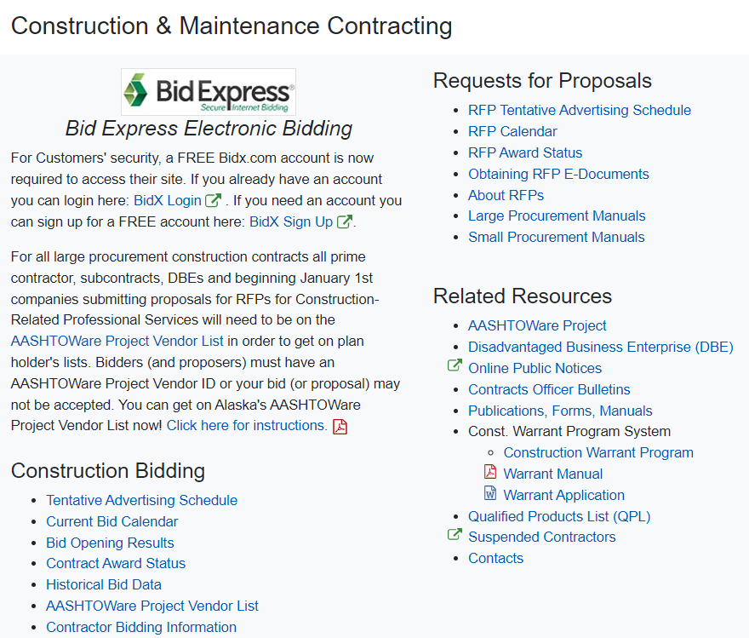

Finding Opportunities
Looking for the contracts – searching for solicitations & bid opportunities
  State of Alaska:
    Alaska Public Notices
    IRIS Vendor Self-Service (VSS)
    Department of Transportation & Public Facilities Procurement
      Tentative Advertising Schedule
      Current Bid Calendar
https://dot.alaska.gov/procurement/

Slide 26
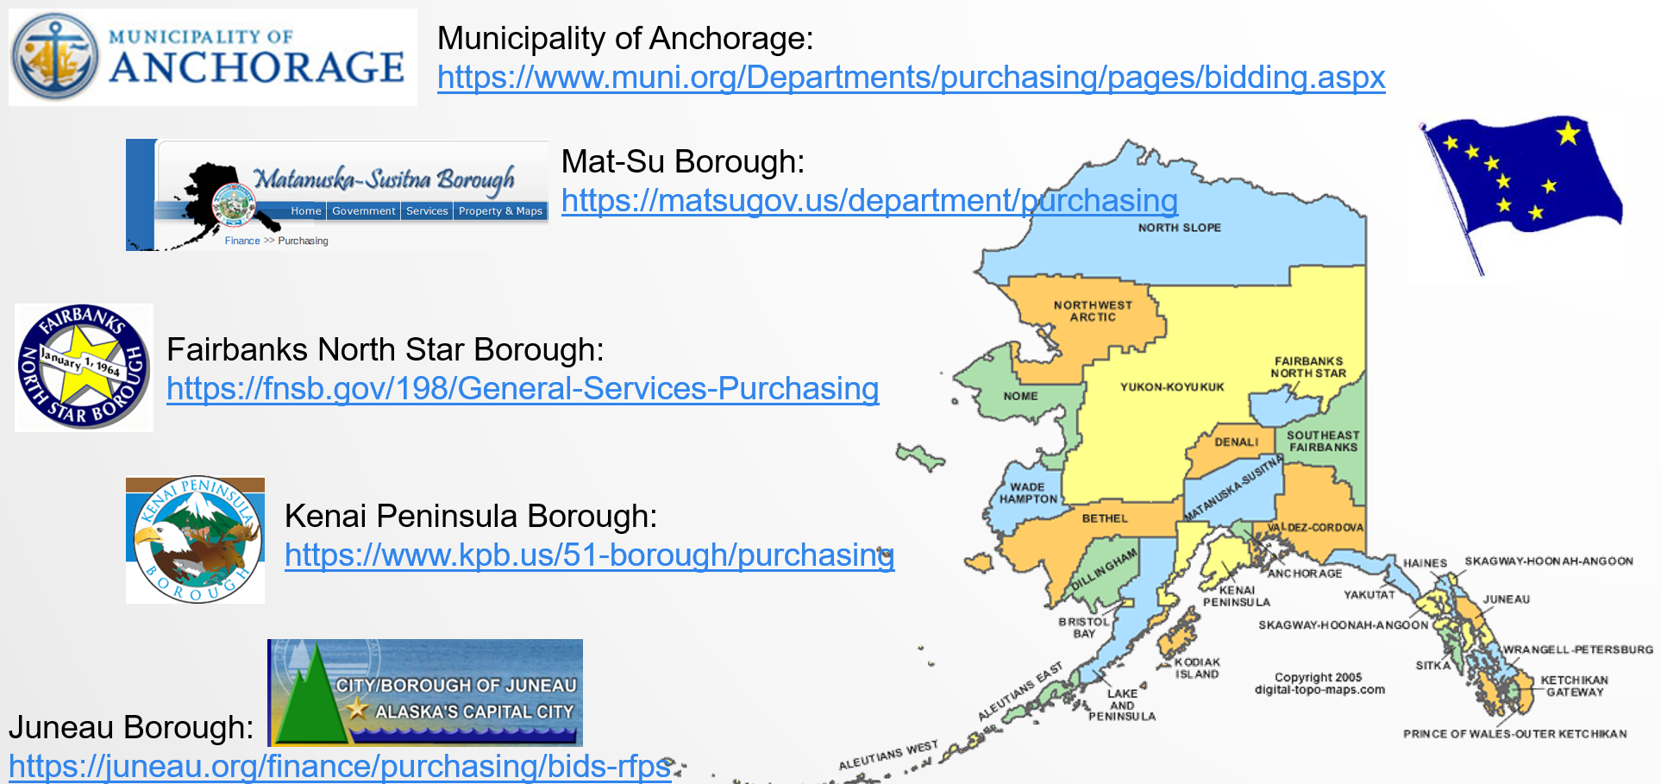
Finding Opportunities
Looking for the contracts – searching for solicitations & bid opportunities
  Municipal
  Borough
  City
  University
  School districts
  Police &
  Fire Department

Slide 27
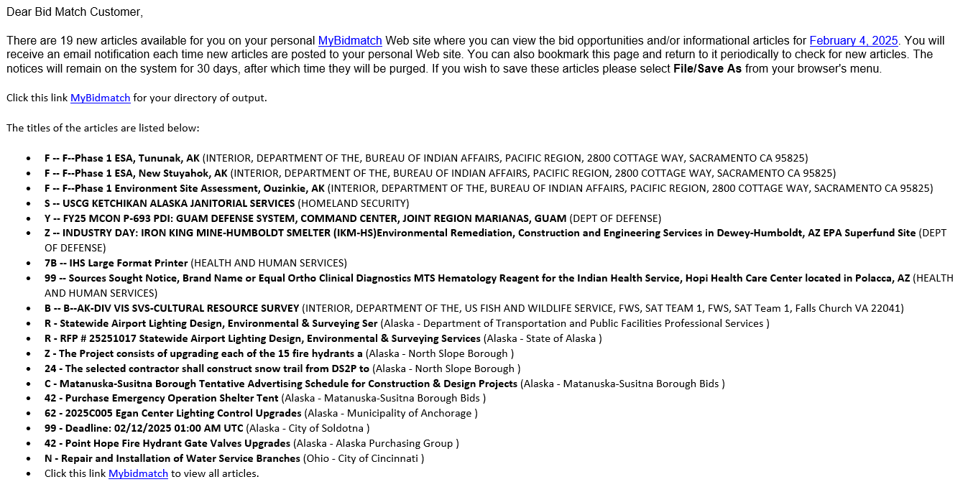
Solicitation Search Software
BidMatch Solicitation Search Software
Next webinar:
February 7, 2025
10:00 am – 11:00 am
Registration link: https://akapex.ecenterdirect.com/events/6460

Slide 28
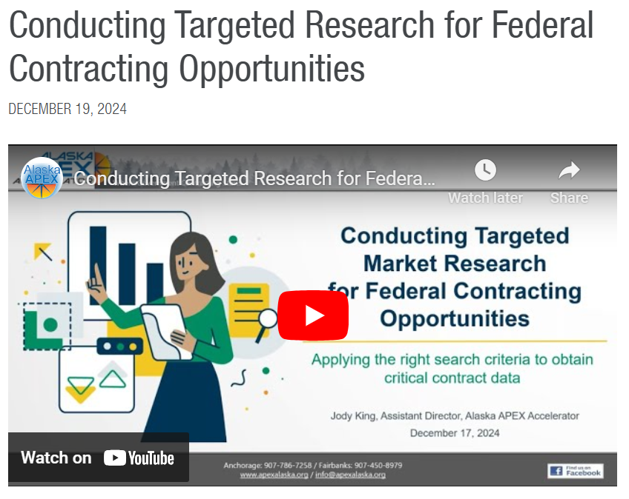


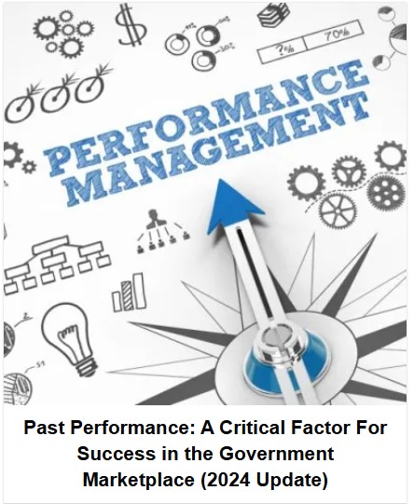
More Market Research Training
https://apexalaska.org/
https://govology.com/
https://govology.com/government-contracting-webinars-courses/?s=market%20research
https://apexalaska.org/training/conducting-targeted-research-for-federal-contracting-opportunities-2/

Slide 29

Building Teaming Relationships
Competitor or Business Partner?

Slide 30
Marketing to Potential “___”
Before you knock on the door looking for potential teaming partners, ask yourself:
  What do you need from them?
  What do you (or your business) bring to the table?
  How can the teaming relationship benefit the potential teaming partner(s)?
  But first, let’s assess your business…
“Honesty is the first chapter in the book of wisdom.”
– Thomas Jefferson

Slide 31

Company Self-Assessment
Why team with another company? What do you need to complete the next contract, break a bottleneck, or diversify/expand into another area?
  Physical Capital
  Human Capital
  Intellectual Capital
  Financial Benefits
Before entering into a
teamed / contractual business relationship, assess your own company standing.
What does your company need and what can it offer?
    https://americassbdc.org/8-reasons-to-consider-collaborating-with-another-small-business/

Slide 32

Ability, Capacity & Capability
Ability – the skill, knowledge or power to do something
Capability – the ability to do something in “either/or” scenarios; The capability of a business refers to its ability to do something when all its resources are optimally employed.
Capacity – the innate potential; the business capacity refers to the maximum level of output that it can yield and deliver within inherent limitations
Ability | Capability | Capacity (Max level of output)
Staff (People): - Management - Key Personnel W-9 Employees - Subcontractors Staff Training & Certification Contingency Plans Standard Operating Procedures | Past Performance - Completed projects Existing Master Subcontract Agreements Contingency Planning & Resources Accounting Systems Job Codes Cost tracking mechanisms | Bonding Capacity - Maximums: Ceiling & Project limitations - Available Bond Amount? Work in Progress - Availability of Manpower Availability of Equipment Financial Resources Risk Management Limitations Contingency Resources Supply Chain Availability Inherent Limitations

Slide 33
Teaming Strategies
Competitors vs. Potential Teaming Partners
  Business growth: more employees or strategic partnering?
  What business bottlenecks are slowing business growth?
  Diversification – new locations or new product and/or service lines?
  But first, let’s define teaming…
“Coming together is a beginning. Keeping together is progress. Working together is success.”
-Henry Ford

Slide 34


Teams vs Joint Ventures
Prime/Sub Teams
Only one party (prime) performs at the prime contract level and is responsible to the government
Subcontractor typically paid on a pre-determined basis
No new legal entity created
Subcontracting limits apply to prime only (but note similarly situated entity rule)
Joint Ventures
Both parties perform at the prime contract level and are responsible for the entire contract
Parties typically split profits and losses
Parties create a new legal entity (e.g., LLC) & registered in SAM
Subcontracting limits apply to JV as a whole

Slide 35

Prime/Sub Teams
Prime/Sub Teams – Teaming Agreements
Privity of Contract: 1 to 1 relationship between government and prime contractor
Teaming Agreements
  FAR does not require prime/subcontractor teaming agreements
  Procuring agencies sometimes (perhaps increasingly) require teaming agreements to be submitted with proposal
    These agencies may decline to consider a subcontractor’s past performance, capabilities, etc. without a teaming agreement
  Lock-in commitments from prospective teammates
    Prime doesn’t want to rely on prospective subcontractor’s qualifications & resources, only to have a subcontractor decline to participate
    Subcontractor doesn’t want to spend time and energy on proposal only to receive no subcontract
  Establishes rules (if any) for exclusivity
  Avoid difficult post-award disputes
  Demonstrate compliance with key requirements

Slide 36

Subcontracts
Prime/Sub Teams – Subcontracts
Subcontracts
  Teaming agreements ➔ Subcontracts: Teaming agreement is a “chasing the contract document” and a subcontract is a “performing the contract” document.
  More detailed – project and/or scope specific
  Must include mandatory FAR provisions
    A flow-down is a provision of a prime contract that the prime contractor includes in a subcontract. FAR required primes to flow-down many clauses – failing to flow-down, when required, is a breach of contract!
  This is a negotiated agreement and should be specific to a singular contact activity. Subcontractors should be ready to push back against non-compliant terms
    Scope of Work should be specific to avoid disputes
    Payment & invoicing provisions should be included
    Dispute resolution
    Termination provisions: Termination for Convenience and Default
    Non-disclosure provisions
    Ensured compliance with subcontracting limits
    Term of subcontract – how will the prime address contract options?

Slide 37
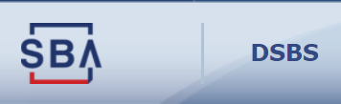



Looking for potential partners
Where to find potential teaming partners
  Dynamic Small Business Search (DSBS)
  System for Award Management (SAM.gov)
  Federal Procurement Data System (FPDS)
  State of Alaska DBE Directory (or other state directories)
  Professional Organization training or networking events
              Vetting potential teaming partners
                Dynamic Small Business Search (DSBS)
                Federal Procurement Data System (FPDS)
                Contractor Performance Assessment Reporting System
                (CPARS) – past performance
                Risk Management concerns
                Legal concerns

Slide 38

Looking for potential partners
  Professional Organizations
  AGC – Associated General Contractors https://www.agcak.org/
  SAME – Society of Army Military Engineers https://www.same.org/anchorage
  CFMA – Construction Financial Managers Association https://cafe.cfma.org/lastfrontier/home
  NAWIC – National Association of Women in Construction
  http://www.nawic-ak.org/
  SPMS – Society of Professional Marketing Services https://smpsalaska.org/
  NCMA – National Contract Management Association https://www.ncmahq.org/
  NIGP – National Institution of Government Purchasing https://www.nigp.org/

Slide 39
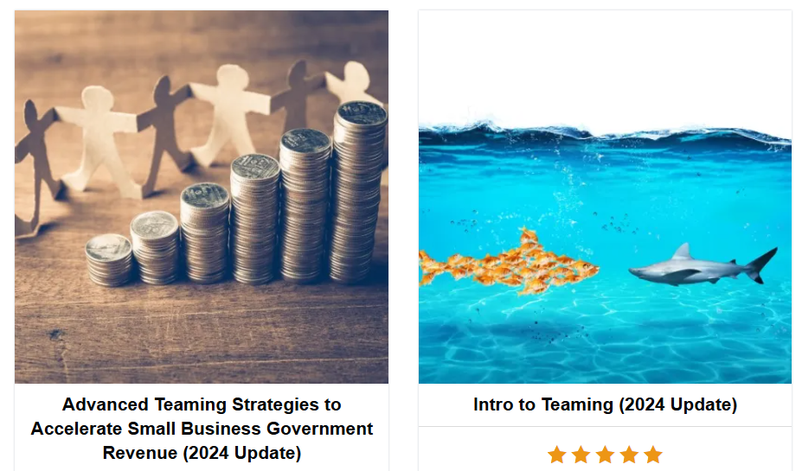

More Teaming Training
https://govology.com/

Slide 40

Marketing & Advertising
How are you promoting your business?

Slide 41
Marketing Your Business
How are you marketing your business?
  Develop a marketing plan – more than just using social media
  Social Media presence – name and brand recognition
  Identifying/promoting your small business certification(s)
  Marketing Materials
    Business Cards
    Capability Statement
    Website – what does it say about your business? Who is your audience?
“Marketing strategy will impact every piece of your business, and it should be tied to every piece of your business.”
– Brandon Andersen

Slide 42
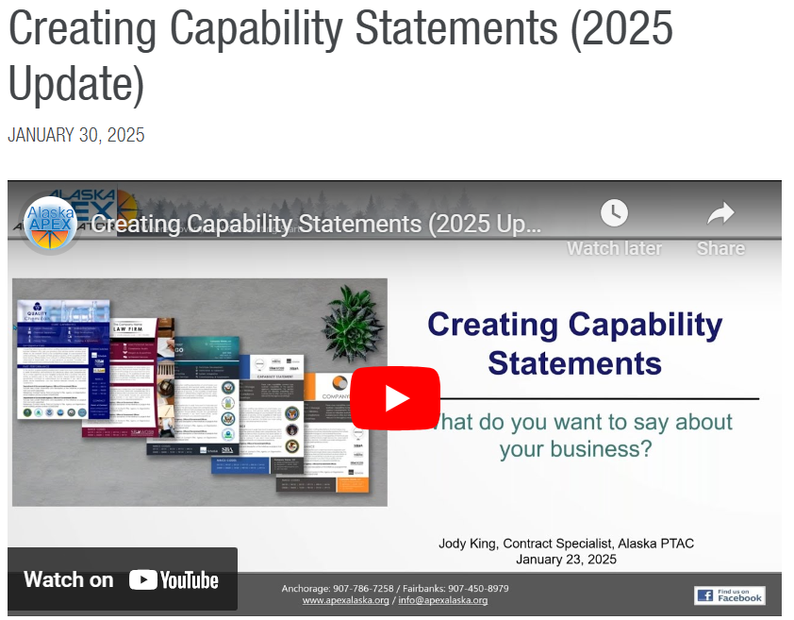
Marketing Your Business
Creating a Capability Statement
  They’re like Pringles – you can’t stop at just one
  Should be written for a targeted reader
  Should fit the purpose of use
  Can be anything from 1 page to
  a detailed catalog
  Add them to your website
https://apexalaska.org/training/creating-capability-statements-2025-update-2/

Slide 43
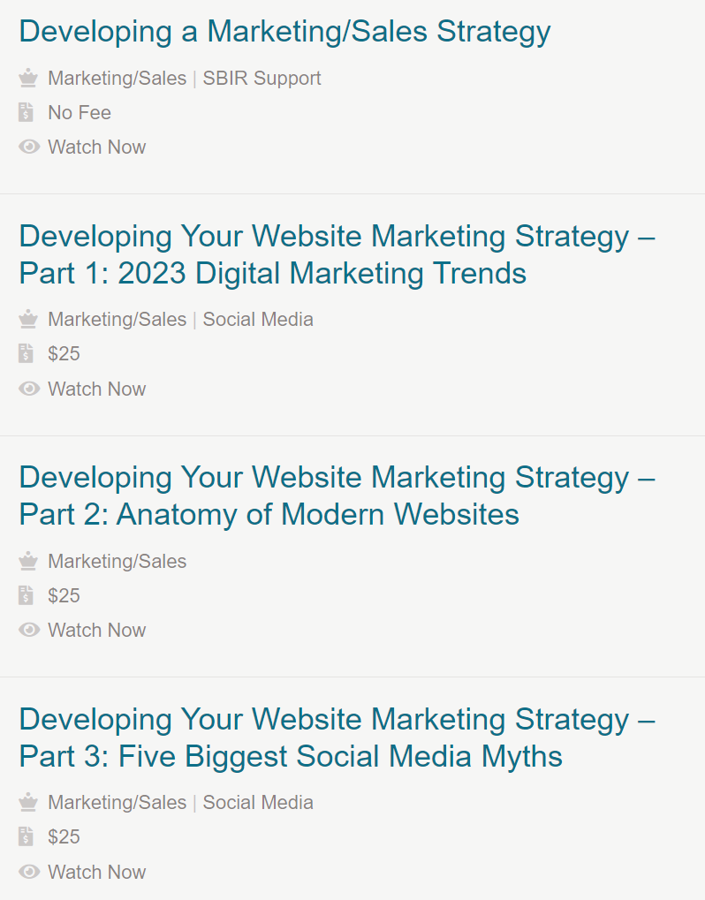

Marketing Your Business
Develop a Marketing Plan
Social Media Presence
Brand and Name Recognition
Website development
https://aksbdg.org
https://aksbdc.org/services/workshops/

Slide 44

Local Resources
Finding the right resource to assist with business growth

Slide 45
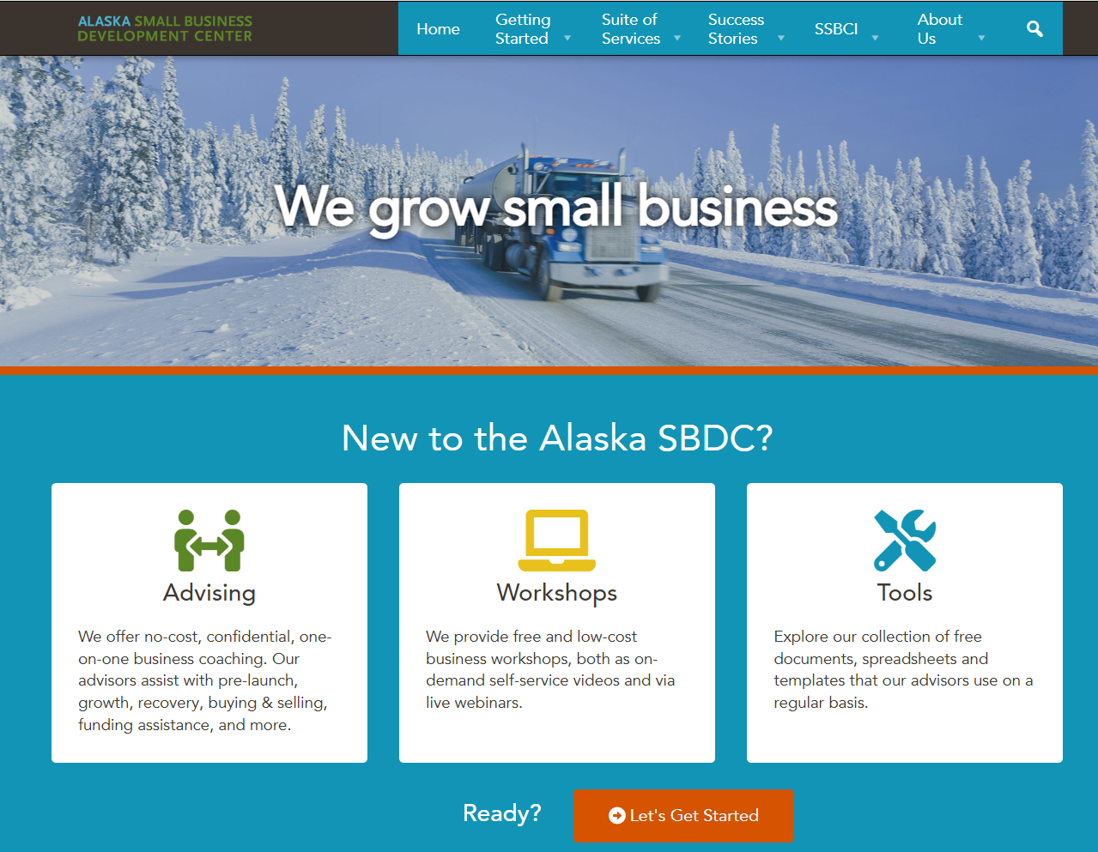
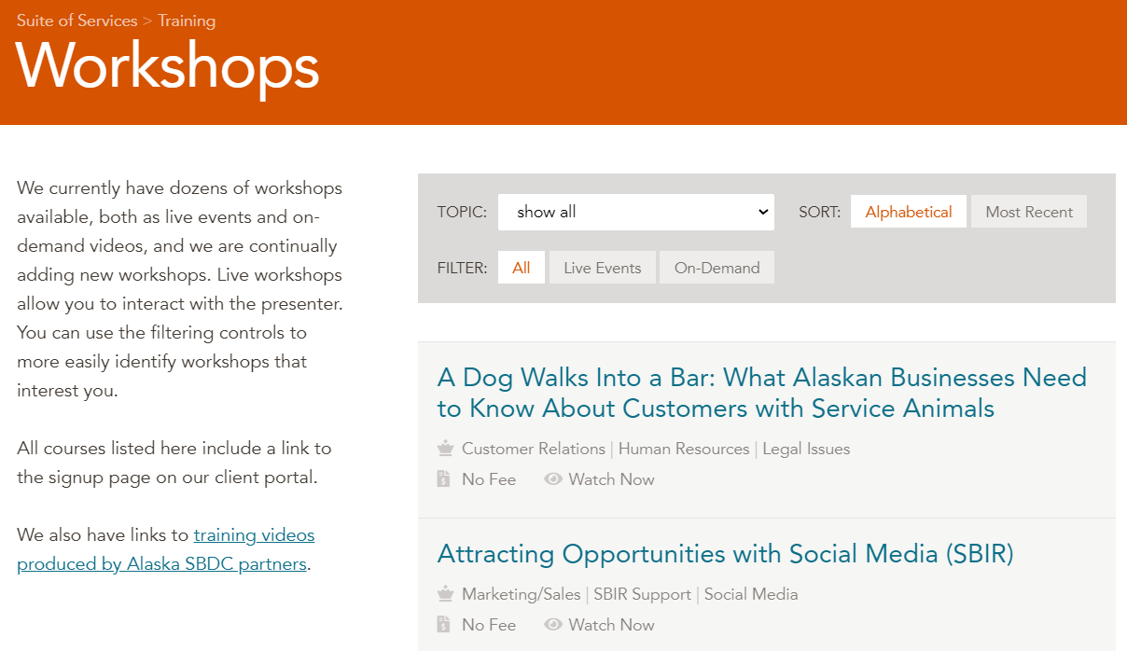

Resources
https://aksbdc.org/

Slide 46
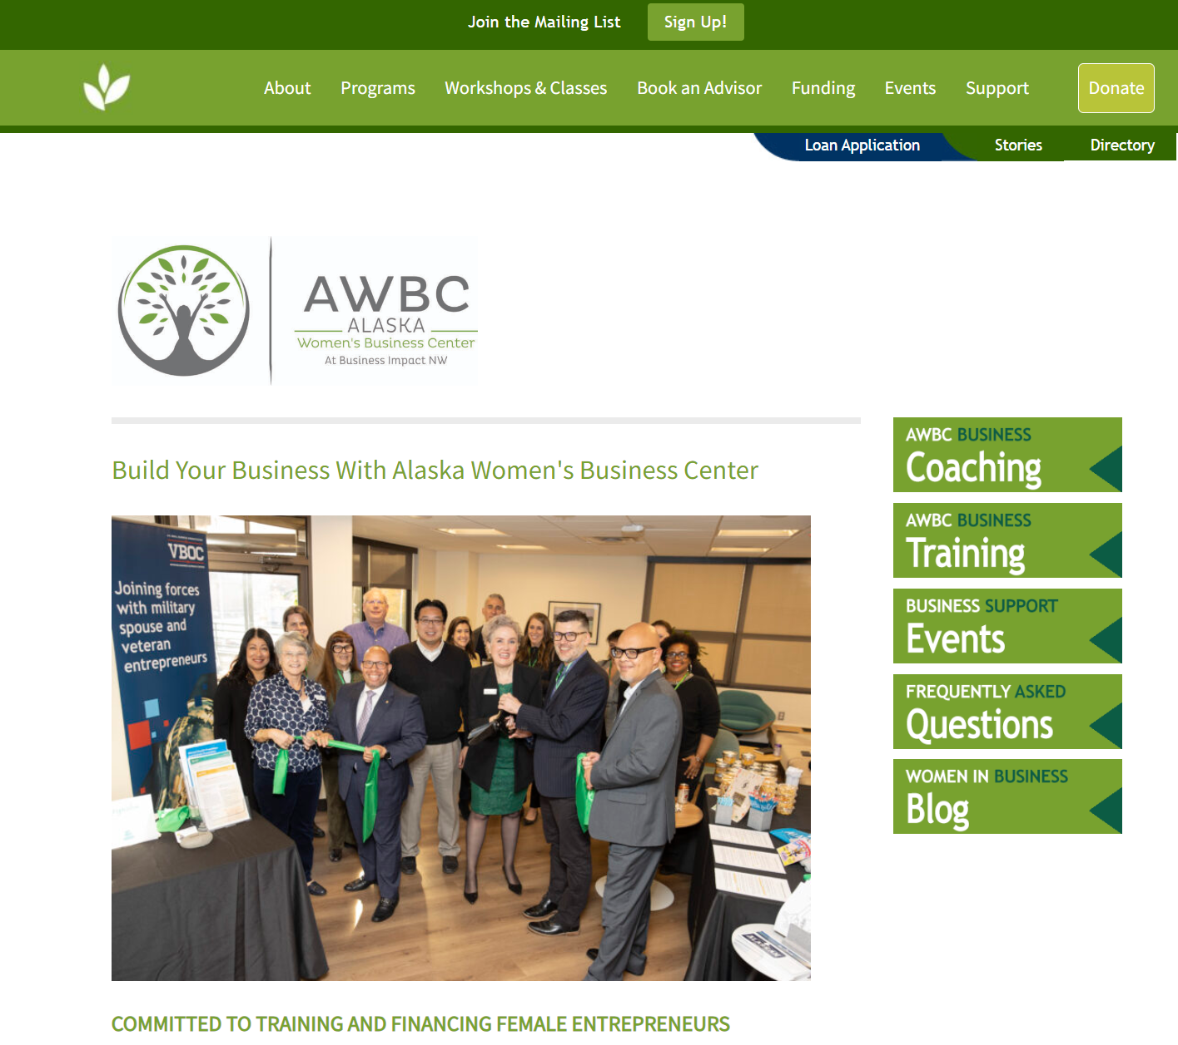
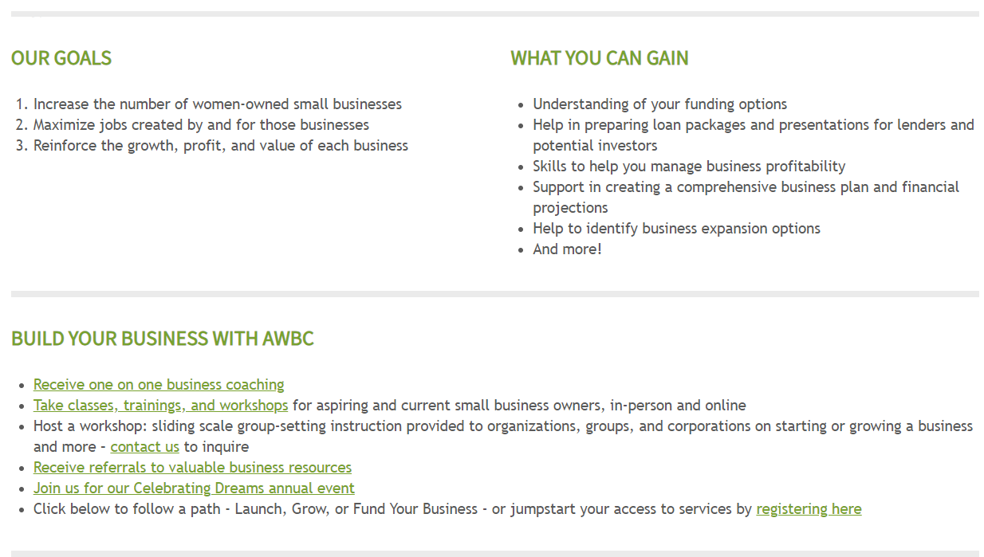
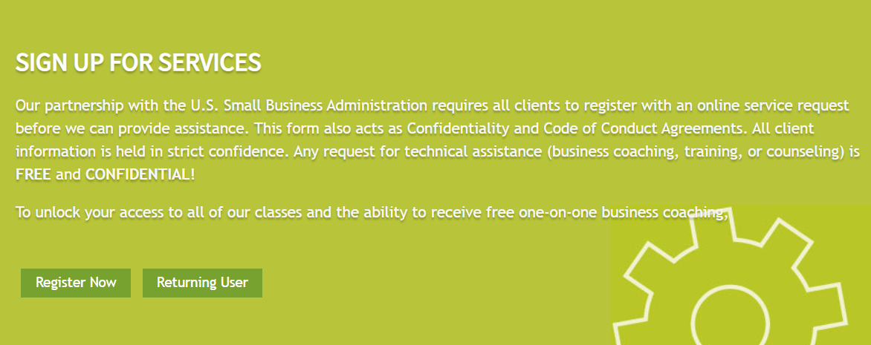
Resources
https://businessimpactnw.org/awbc/

Slide 47
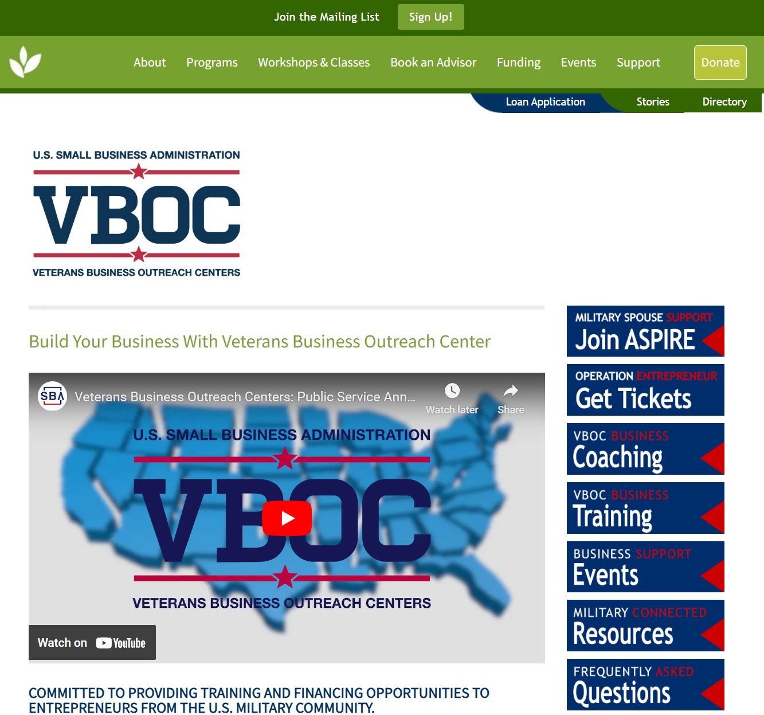
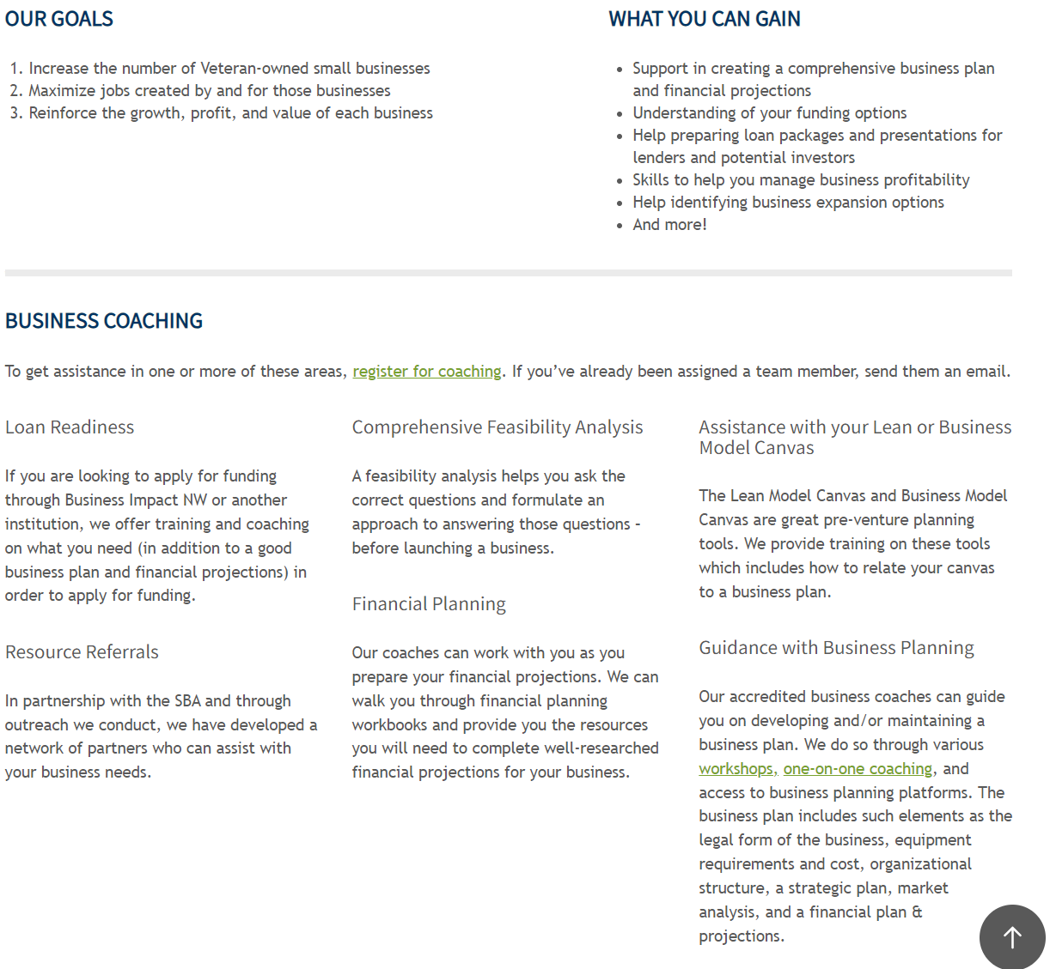
Resources
https://businessimpactnw.org/veterans-business-outreach-center/

Slide 48
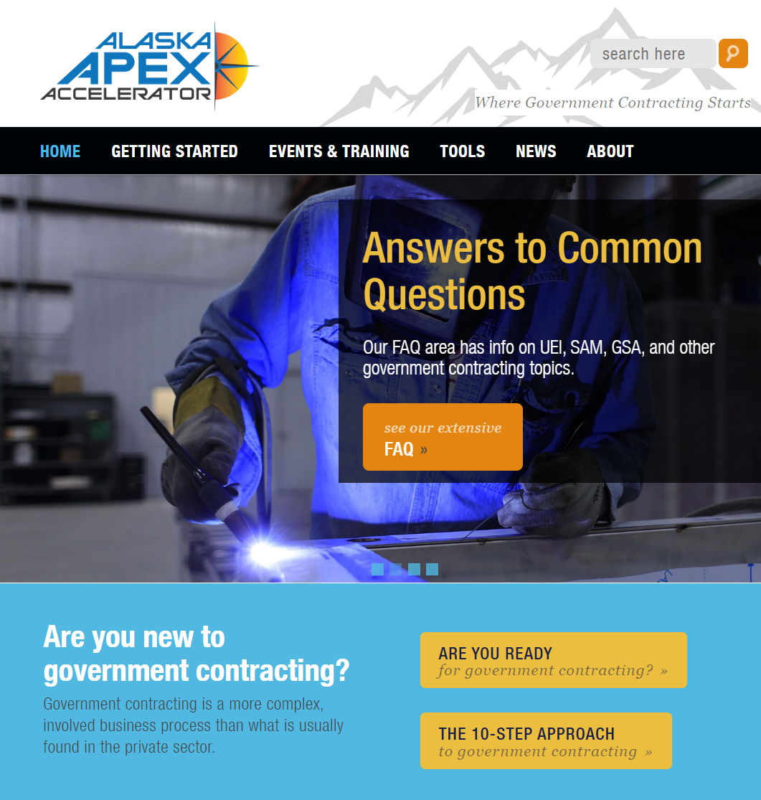

Program Introduction
Free assistance with all aspects of government contracting, from cradle to grave (start to finish) for federal, state and local purchasing activity
Free one-on-one appointments
Free workshops (Special events and extended training session may have registration fees)
The Alaska APEX is one of 96+ other APEX Accelerators across the US, Puerto Rico, & Guam
https://apexalaska.org/
https://www.napex.us/
https://www.apexaccelerators.us/#/
The Alaska APEX is a program of the UAA Business Enterprise Institute and is funded in part through a cooperative agreement with the Department of Defense Office of Small Business Programs

Slide 49
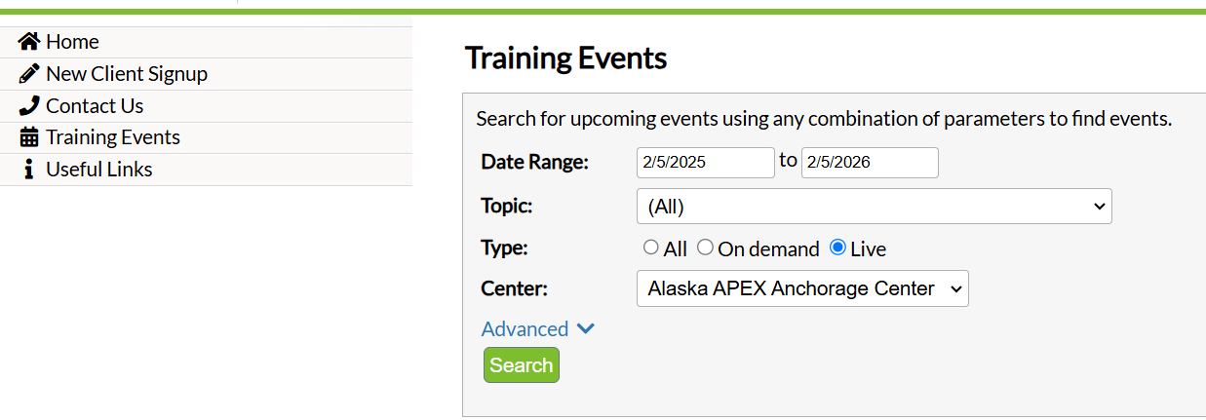
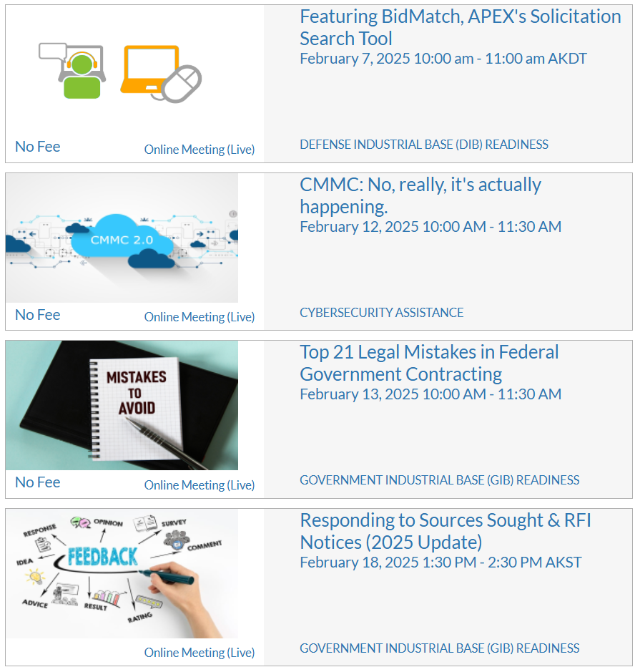
Upcoming Training
https://akapex.ecenterdirect.com/events?reset=1

Slide 50

In Conclusion
Are you ready for government contracting?
  Yes, let’s get started! How can Alaska APEX Accelerator help?
  No, need more information… How can Alaska APEX Accelerator help?
Do the research – what is your start point?
Build relationships with potential business partners and agencies.
Learn the language of government contracting – read the solicitation, ask questions.
Register in SAM then keep your profile active
Update your marketing data in the DSBS
Use solicitation search subscriptions
Obtain applicable small business certifications
Use free resources when needed

Slide 51



Questions?
Alaska APEX Accelerator Staff Contact Information
Anchorage: Phone: 907-786-7258
  Carolyn Pratt, Director/Program Manager capratt@alaska.edu 907-786-7259
  Jody King, Assistant Director jlking8@alaska.edu 907-786-7270
  Craig von Holdt, Contract Specialist II cavonholdt@alaska.edu 907-786-7281
  Tony Taylor, Contract Specialist tltaylor12@alaska.edu 907-786-7239
  Lynda Gregory, Program Specialist lmgregory@alaska.edu 907-786-7258
Fairbanks: Phone: 907-450-8979
  Pierre Thompson, Center Director/Contract Specialist pdthompson@alaska.edu
General email: info@apexalaska.org Website: https://alaskapex.org
To request assistance, sign up here: https://akapex.ecenterdirect.com/signup?reset=1
How can the Alaska APEX help you?

